Slide 1

Data Management ,Analysis and Warehousing for Amazon

Slide 2
Project Overview and Objectives
Exploratory Data Analysis (EDA) – SQL Insights
Data Warehousing and Azure Integration
1
3
2
4
Data Management and SQL Database Setup (Data Overview and Schema)
Exploratory Data Analysis (EDA) – Python Visuals

Slide 3
PLAN FOR PRODUCT LAUNCH
DATA OVERVIEW
(EDA) – Python Visuals
DESIGN
ETL - Azure
Dataset source & Description
ER Diagram (Schema)
SQL queries & Insights
Visual EDA (Cleaning data & Sales Trends and Product Performance)
Key Insights
- Modeling
Data warehouse designing
Develop ETL process using python.
Create Azure solution architecture.

Slide 4
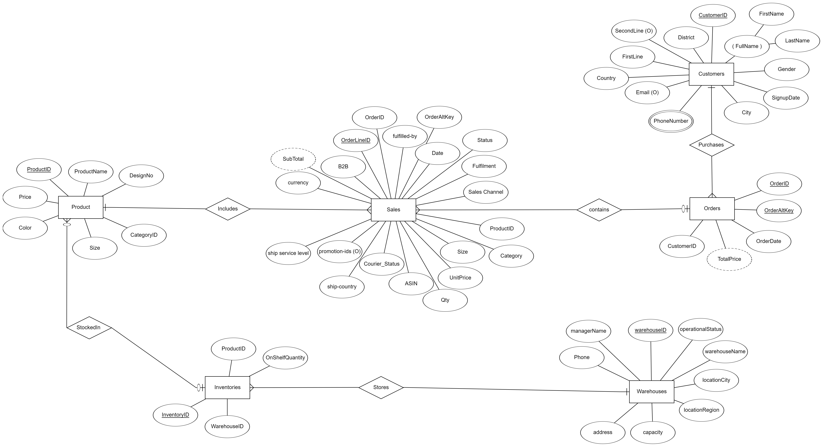
ER Diagram

Slide 5
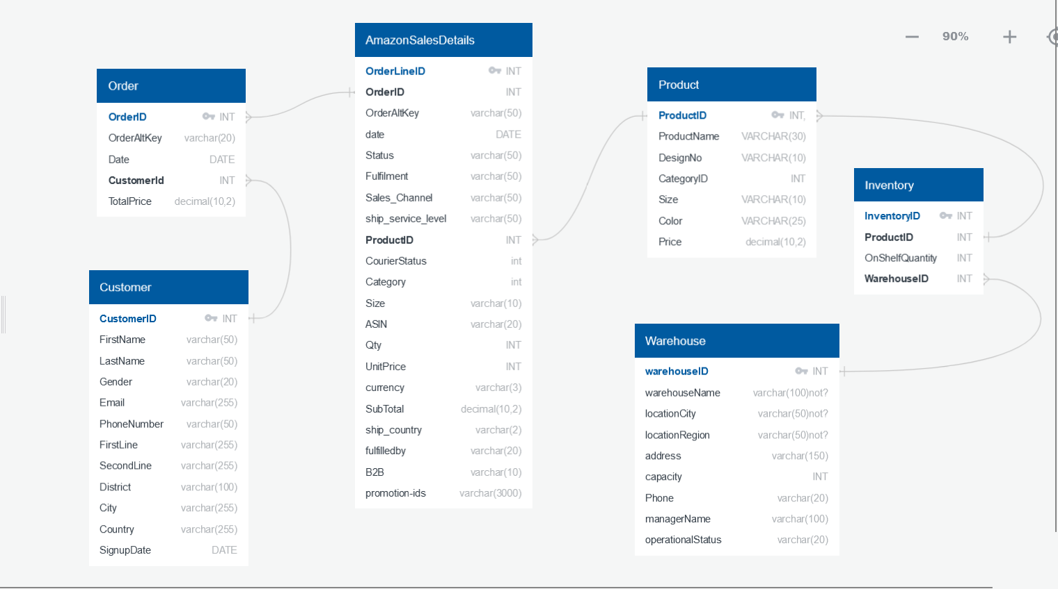
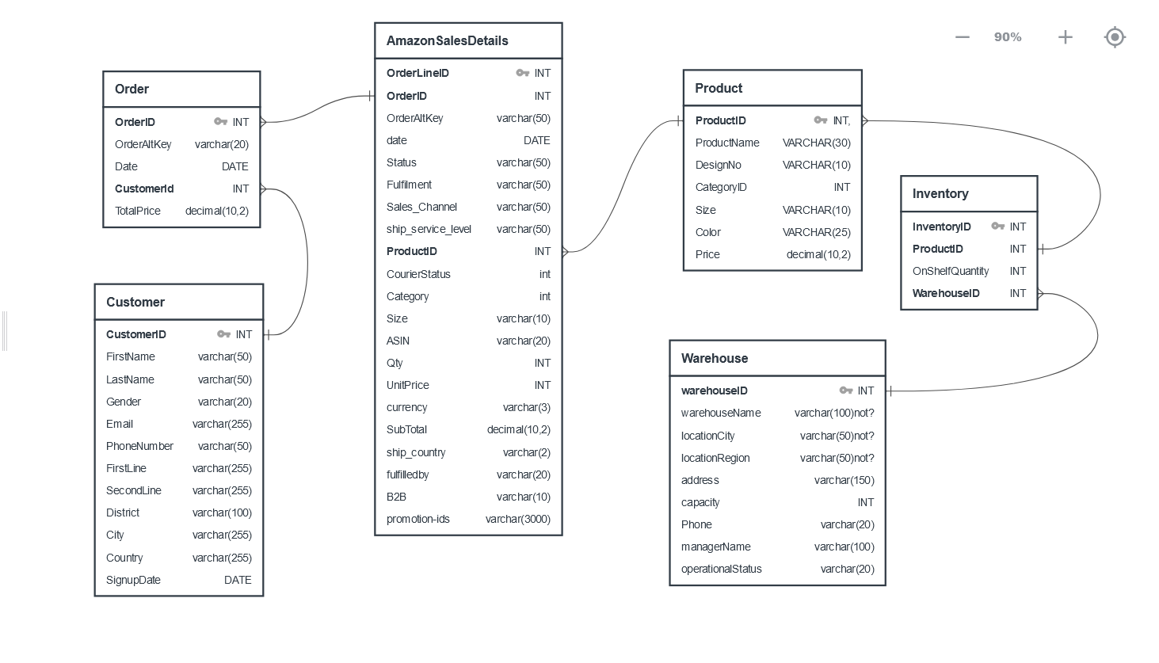
Schema diagram

Slide 6
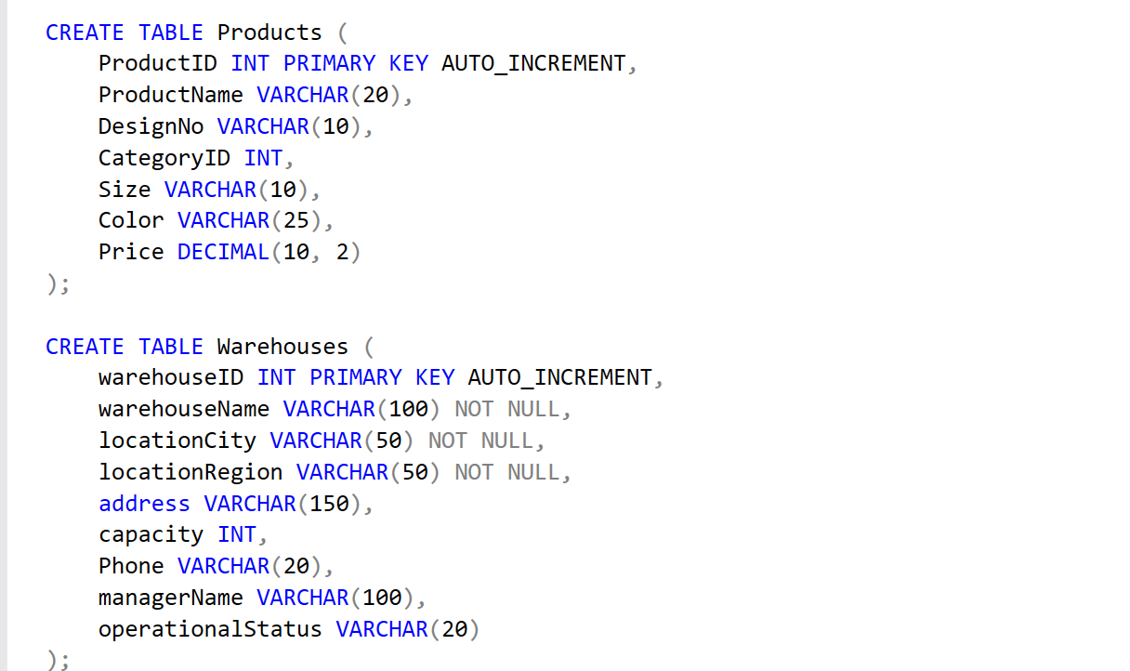
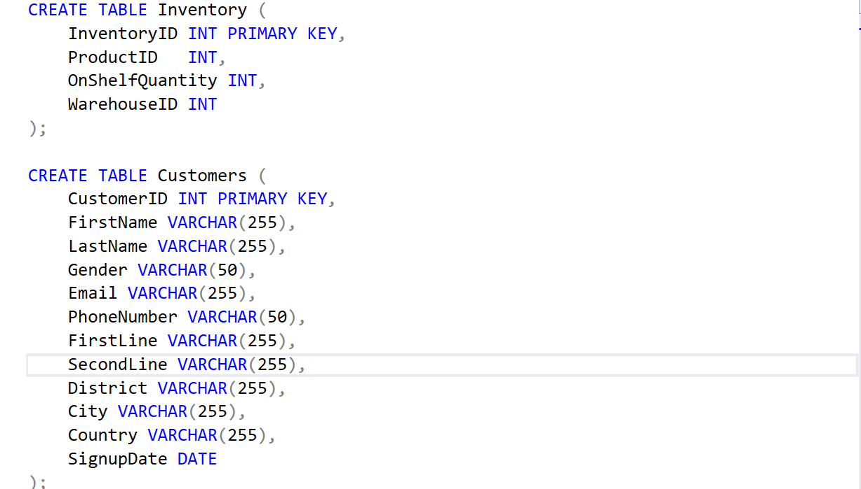
Creation Queries
Creation queries

Slide 7
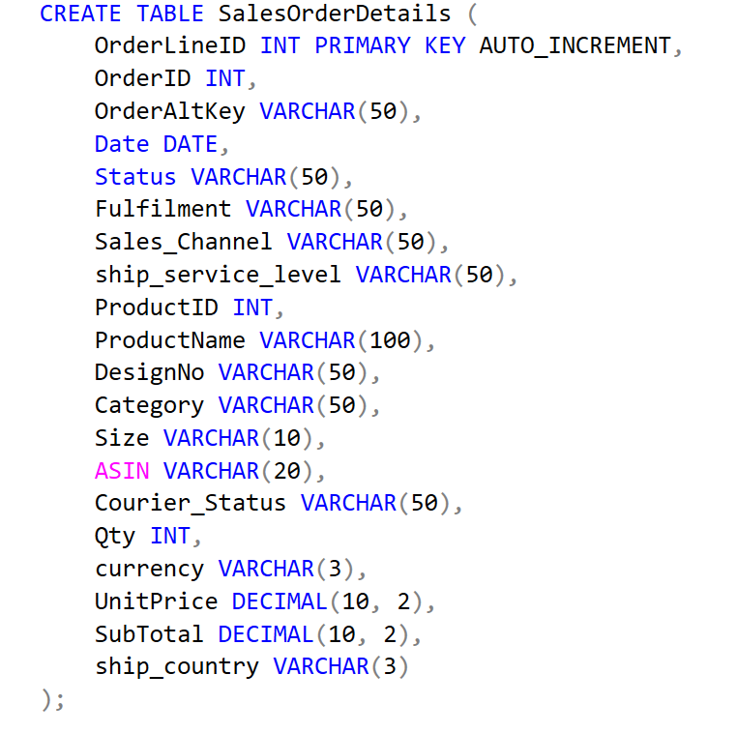
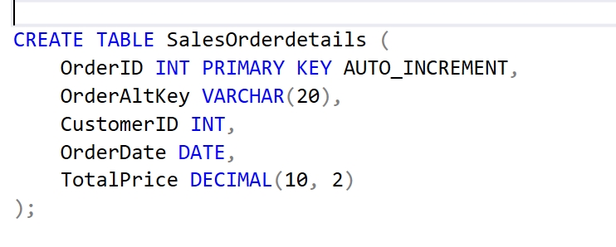

Slide 8
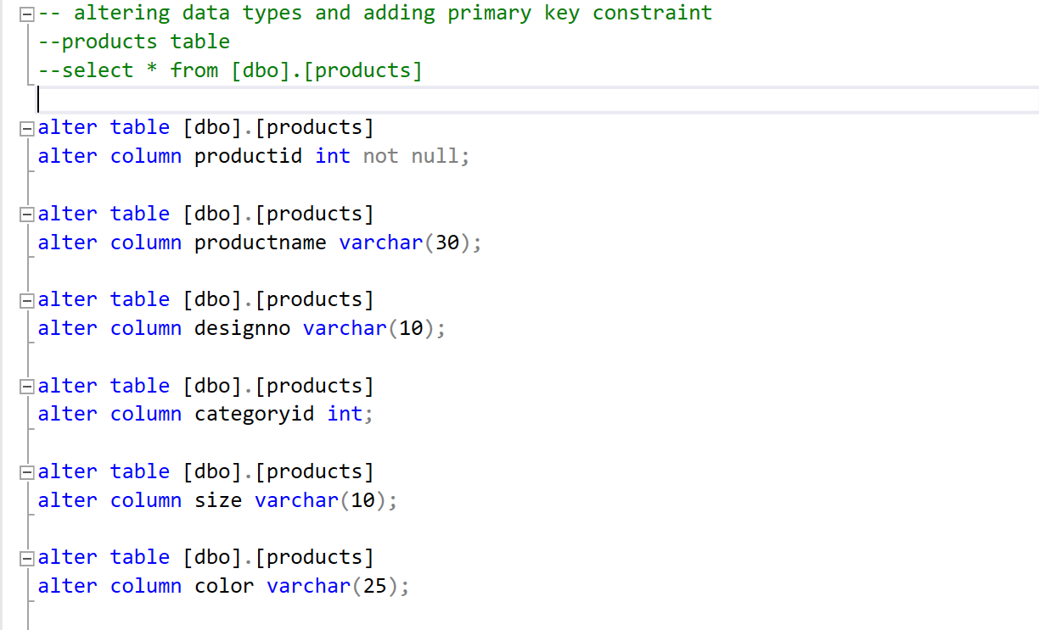
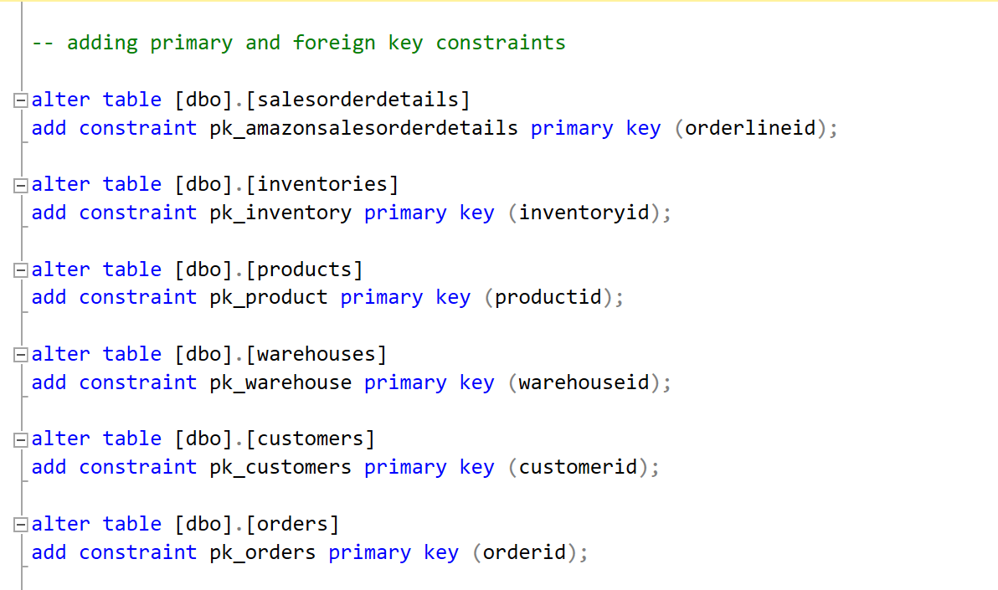
Relational Queries

Slide 9
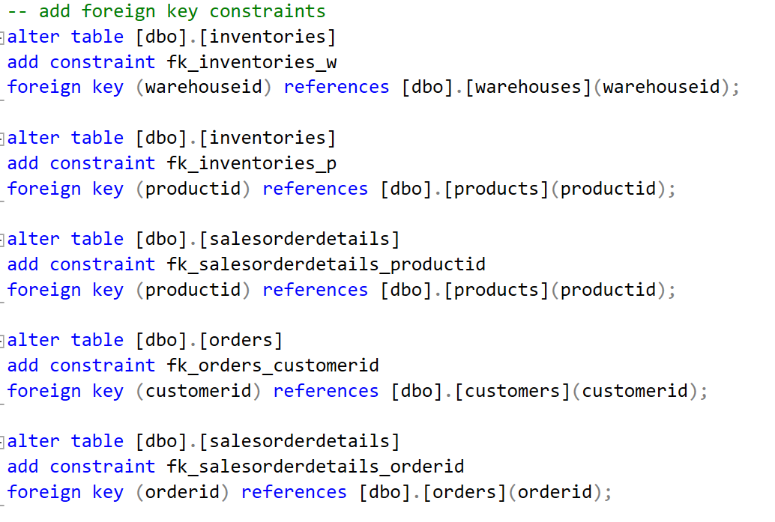

Slide 10
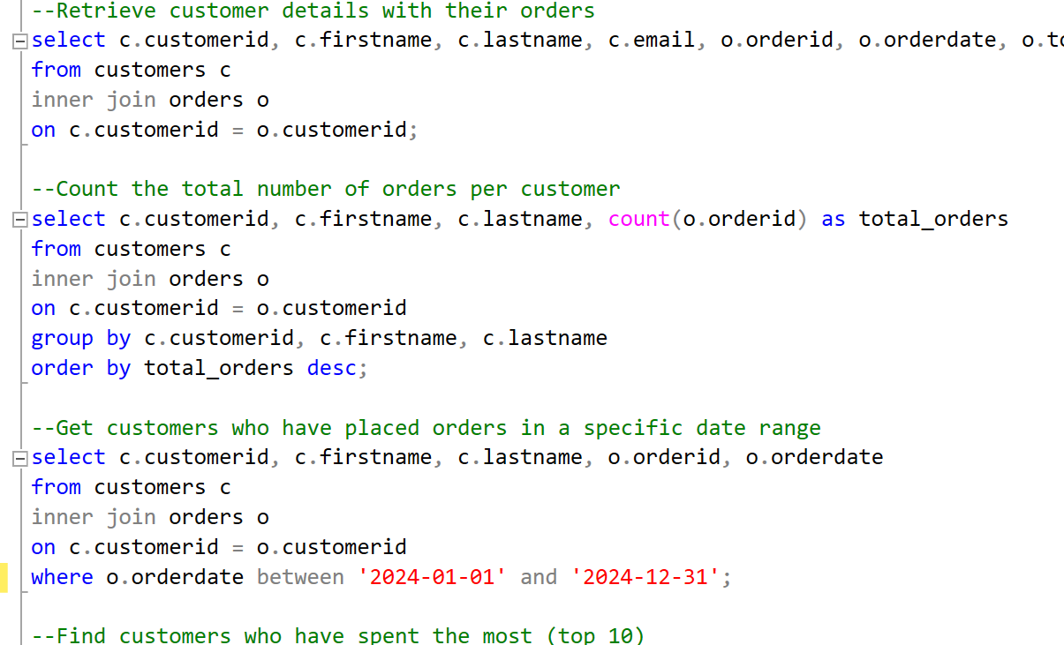
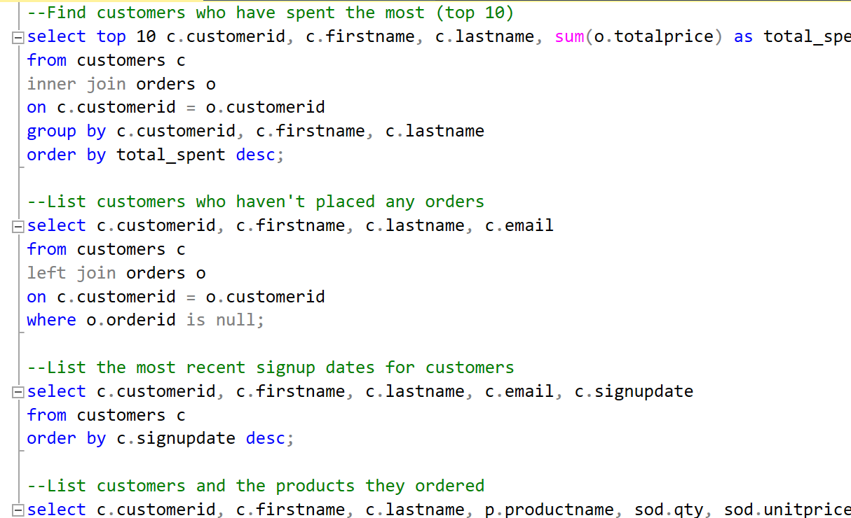
Data exploration Queries

Slide 11
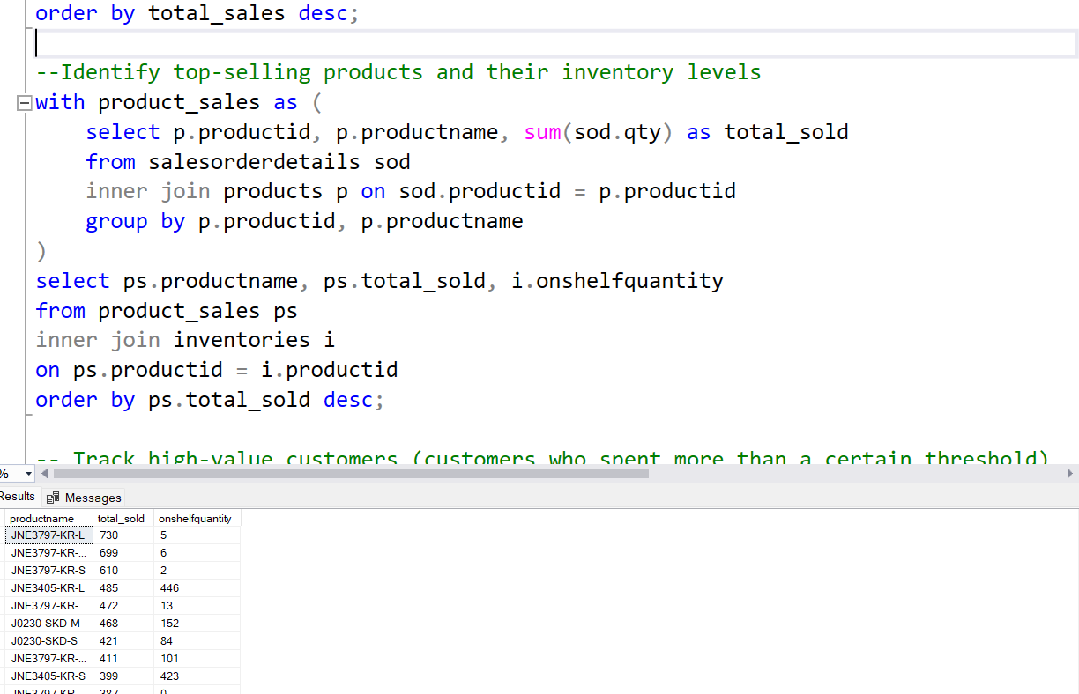
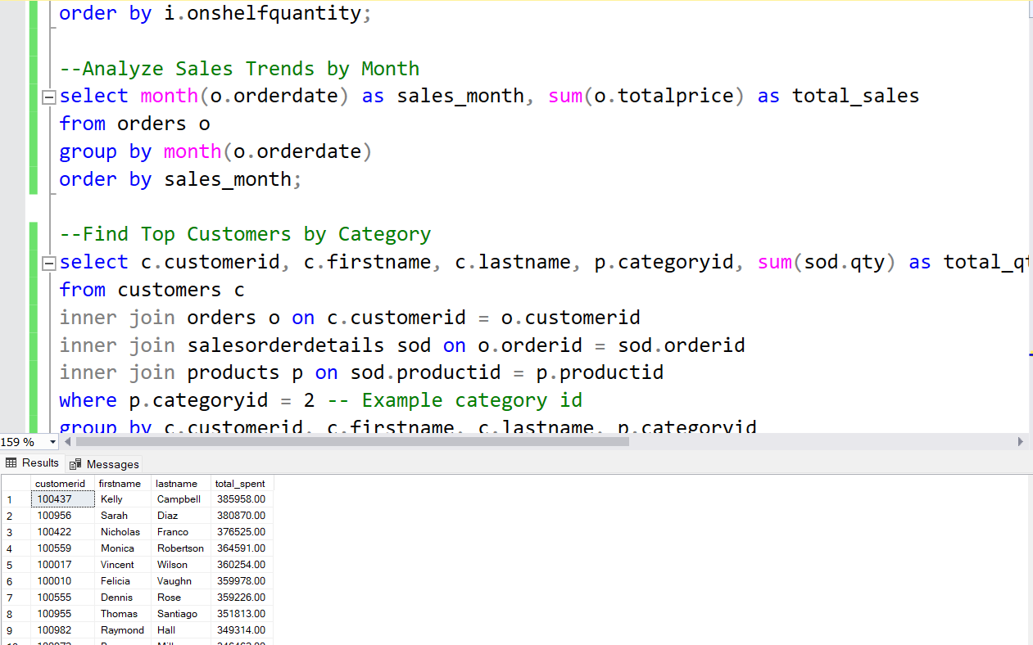
Analytical Queries

Slide 12
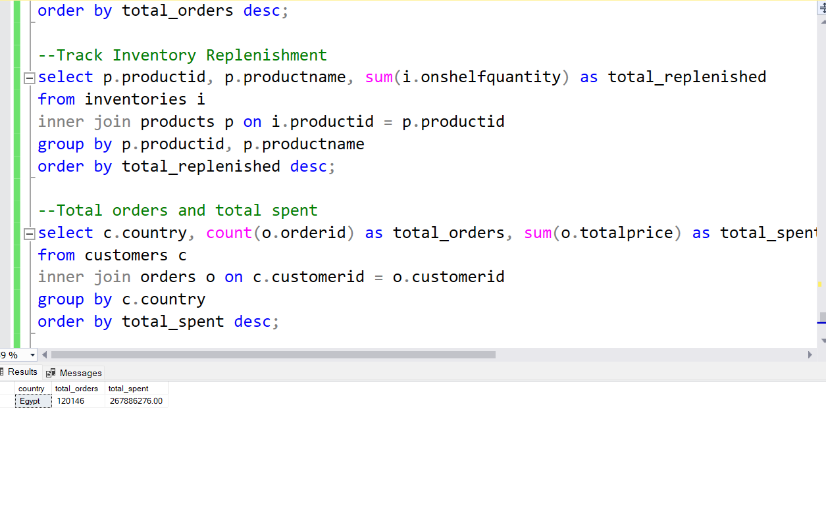

Slide 13
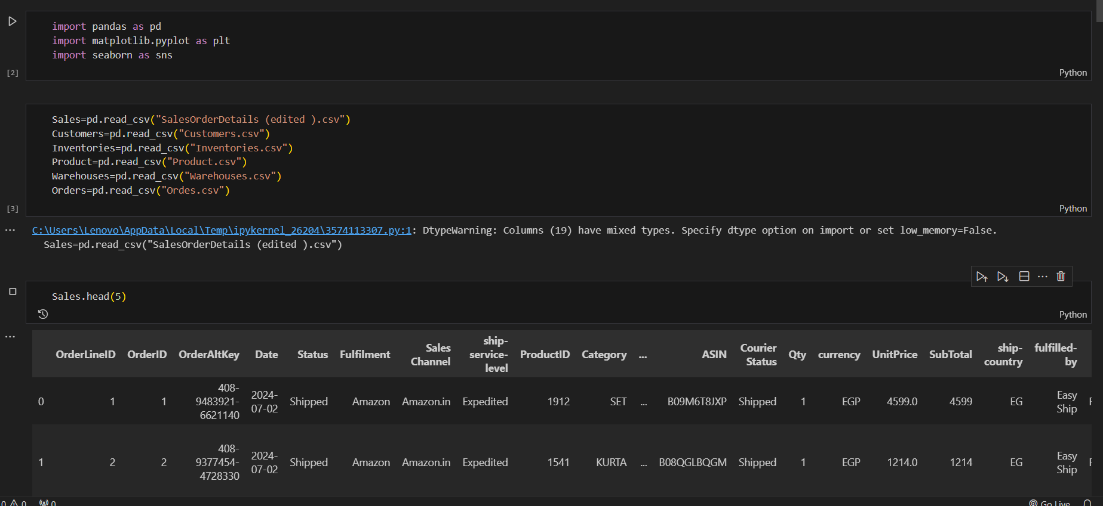
Python- EDA (Data exploration )

Slide 14
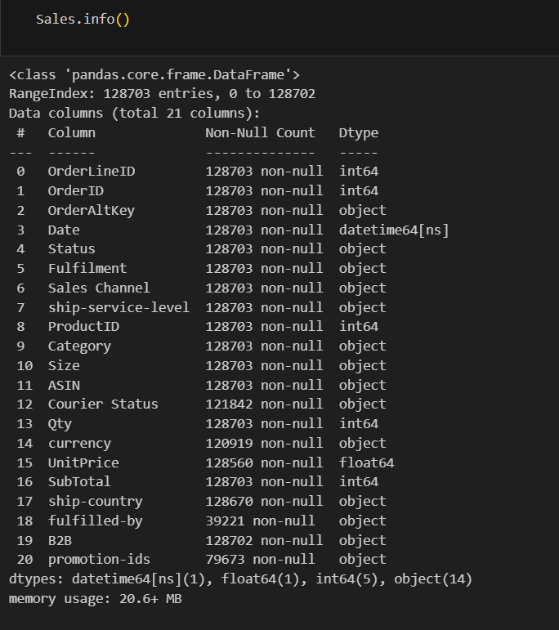
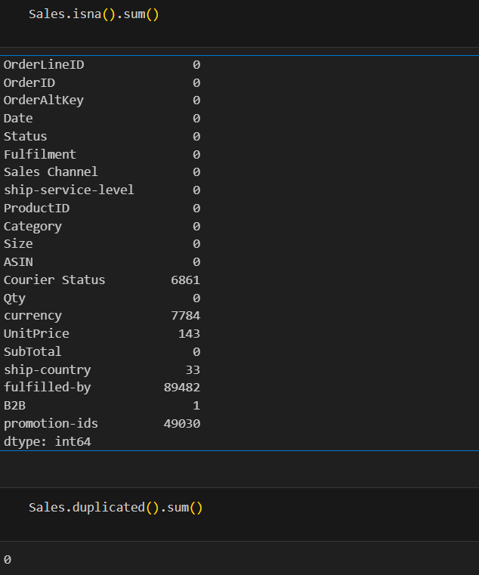

Slide 15
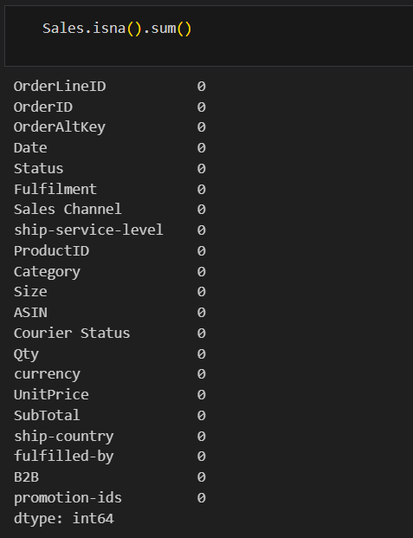
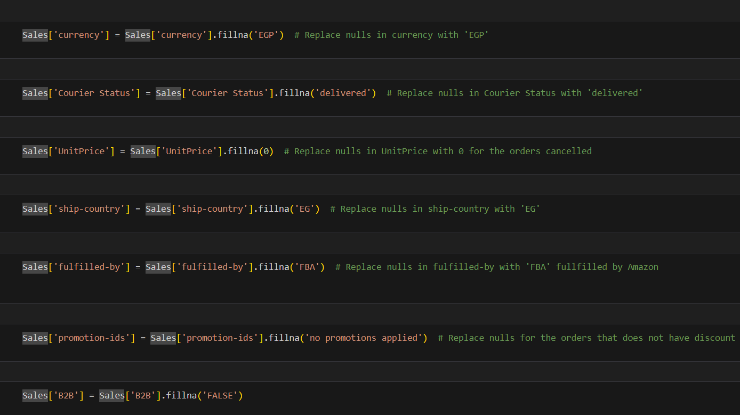
Python- EDA (Data cleaning )

Slide 16
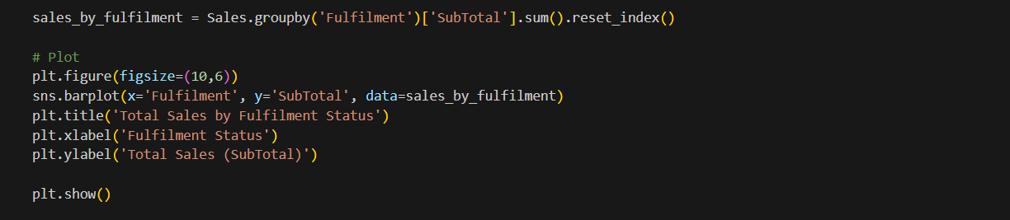
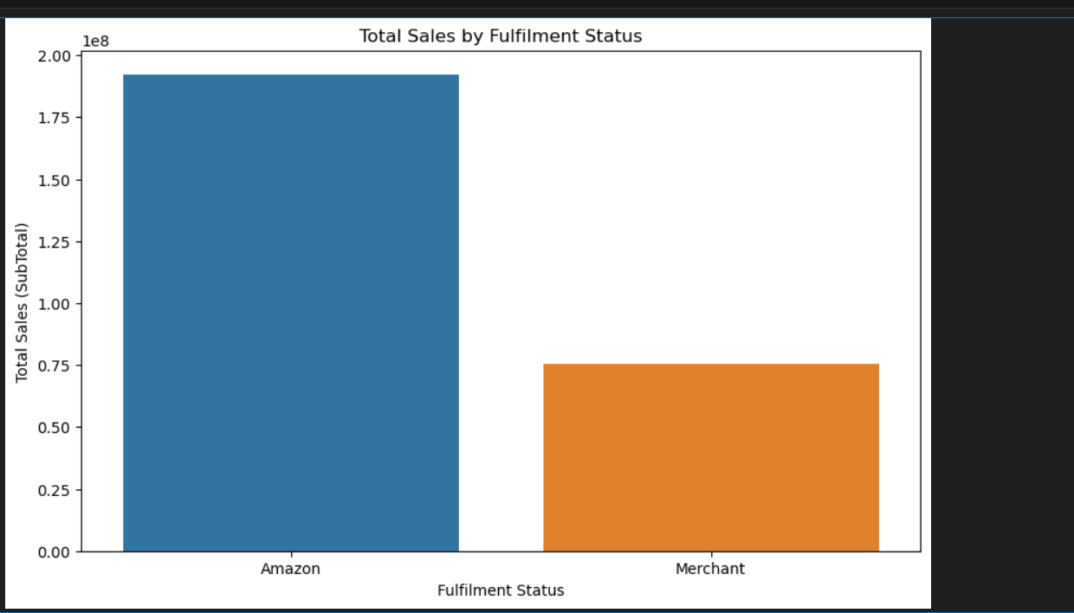
Visualization

Slide 17
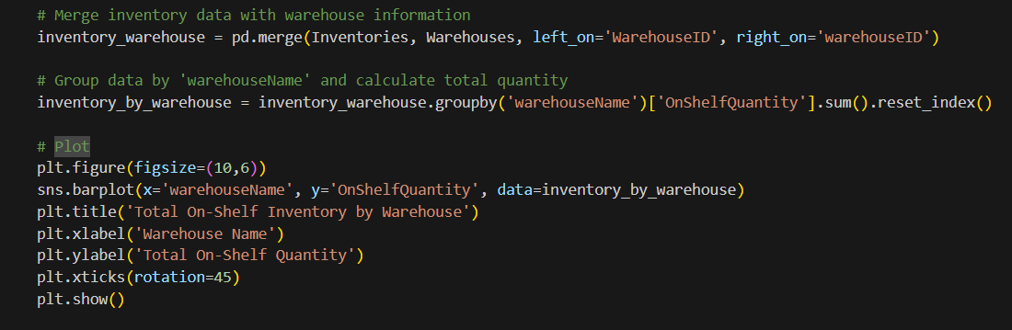
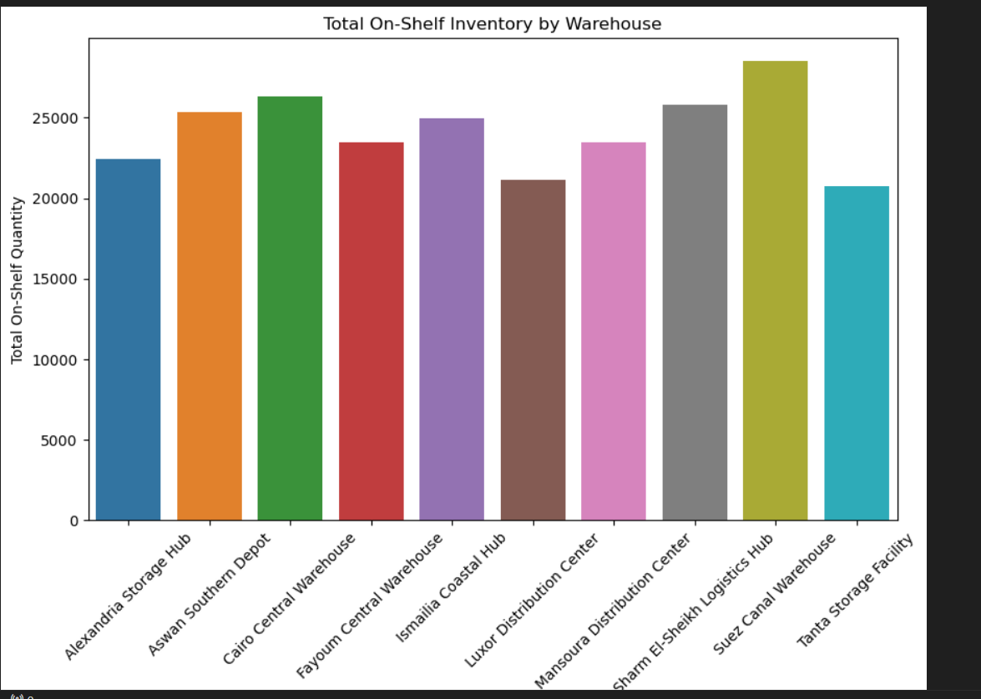

Slide 18
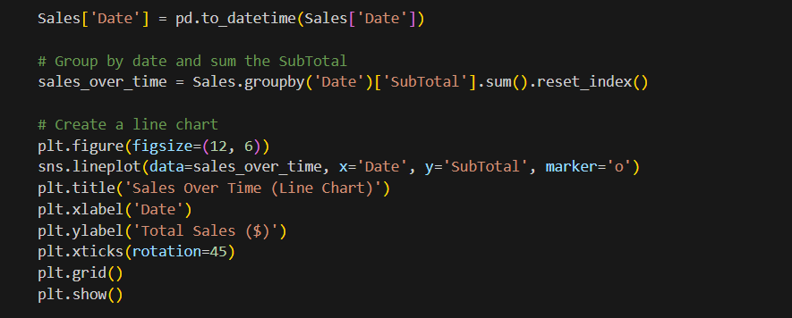
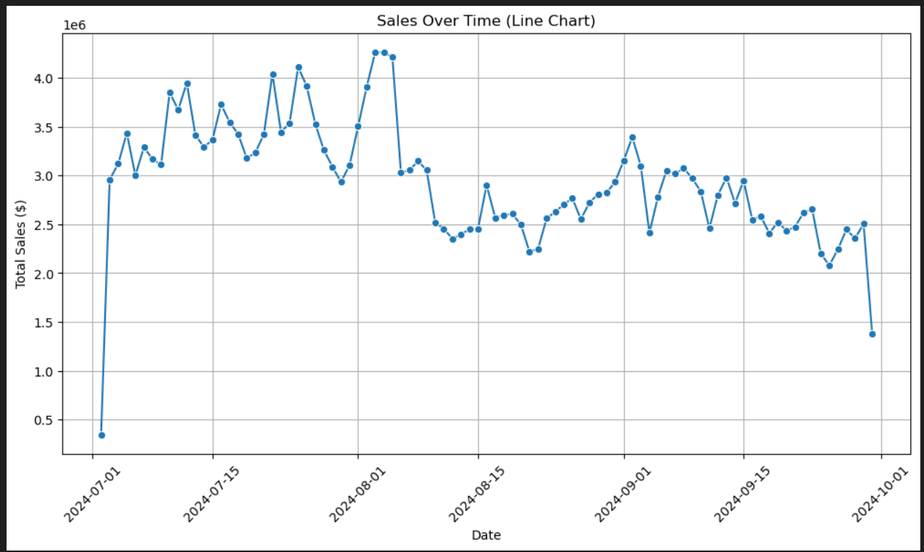

Slide 19
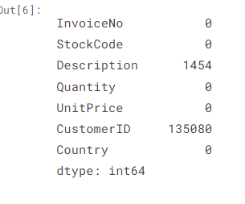
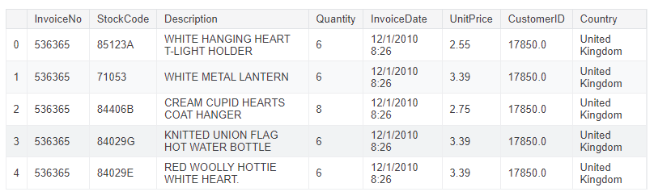
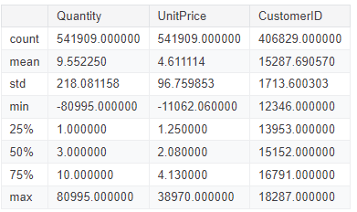
Predicting Sales in E-Commerce
Dataset Overview

Slide 20
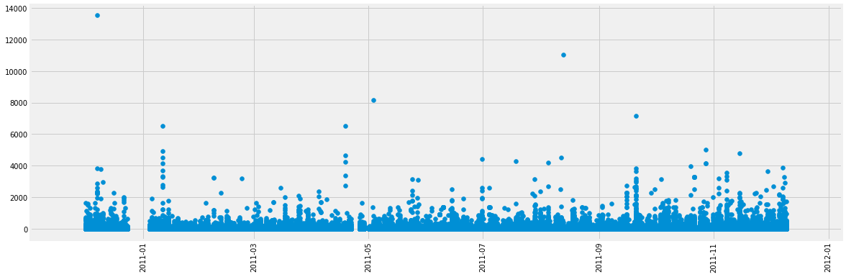
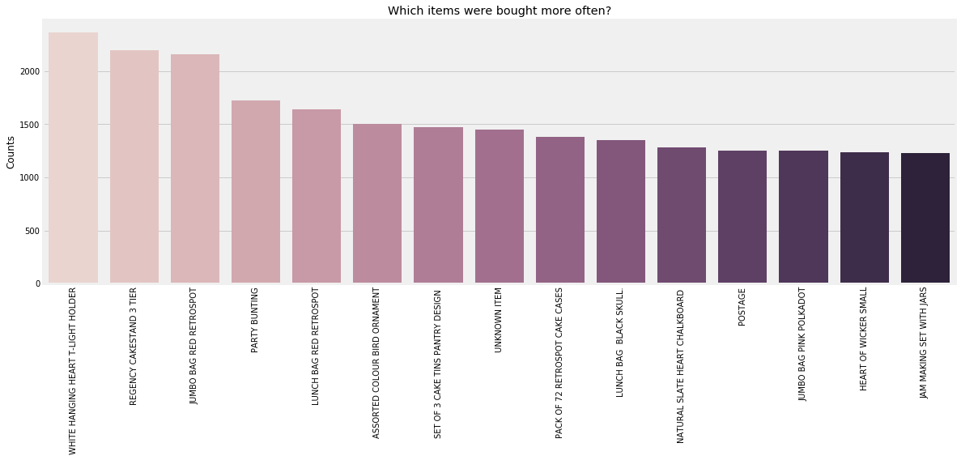
Data Cleaning and Feature Engineering Dealing with null values & Detecting outliers

Slide 21
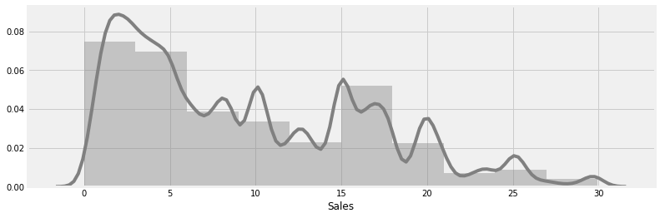
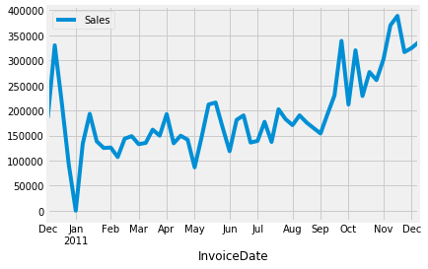
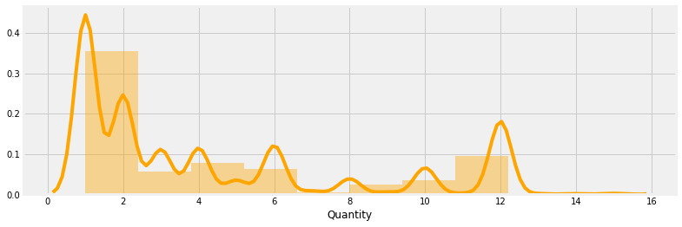
Exploratory Data Analysis

Slide 22
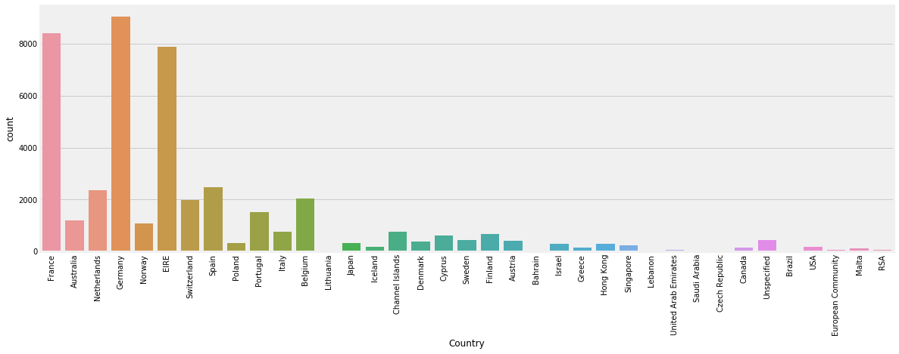
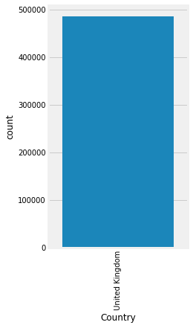
From above plots and calculations we can see that vast majority of sales were made in UK and just 8.49% went abroad. We can say our dataset is skewed to the UK side.

Slide 23
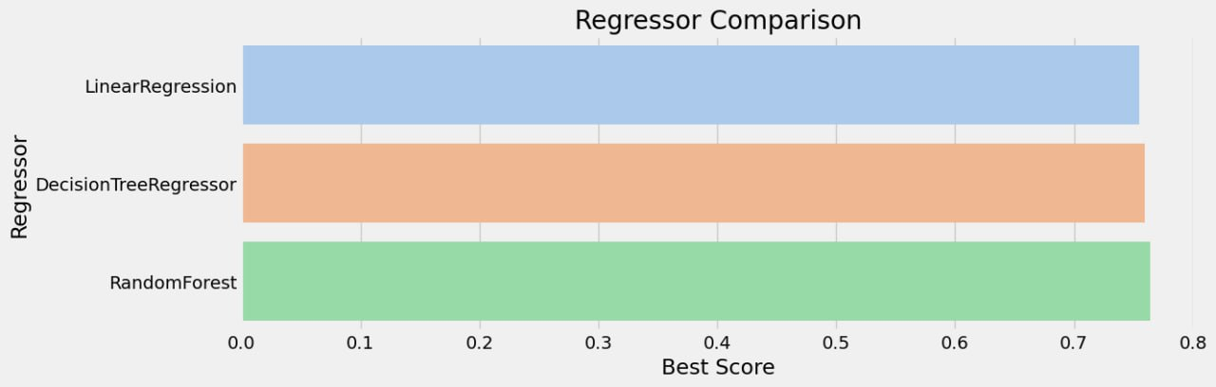
Model Building and Evaluation Do we predict customer churn or lifetime value based on past purchasing behavior?
Model Selection Tested three models: Linear Regression, Decision Tree, and Random Forest. Random Forest performed best.
Achieved 94% accuracy in predicting customer churn. Identified 26,160 customers likely to make future purchases.

Slide 24
Data warehouse layer
Design Data Warehouse
ETL & Data Preparation using python
Build data warehouse using Azure synapse analytics
Load data to Azure

Slide 25
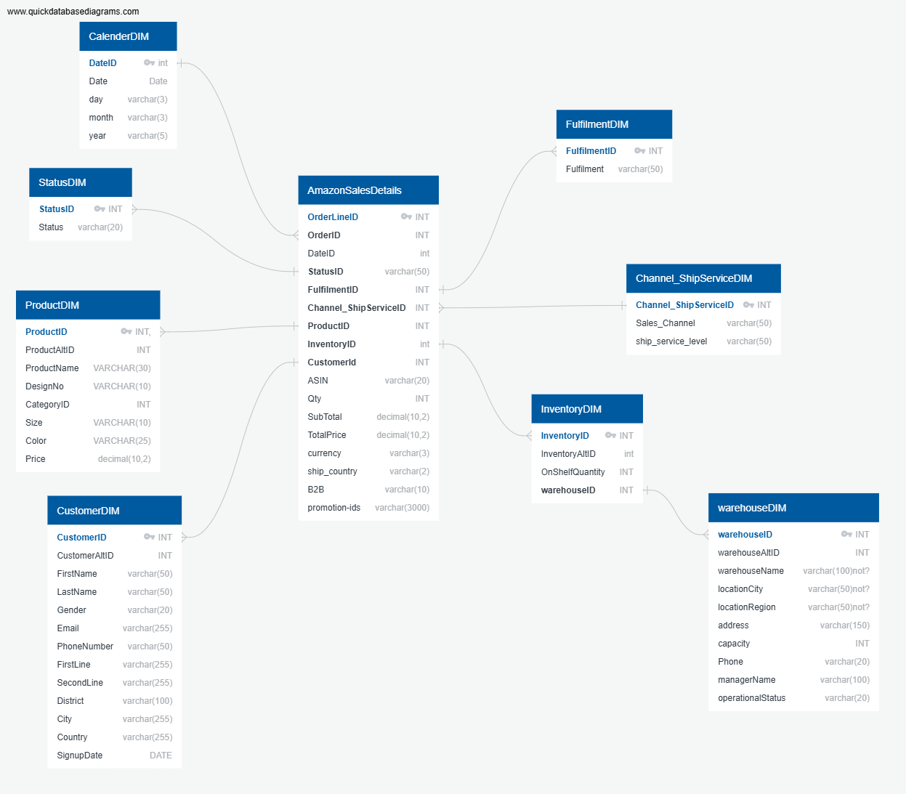
Design Data Warehouse

Slide 26
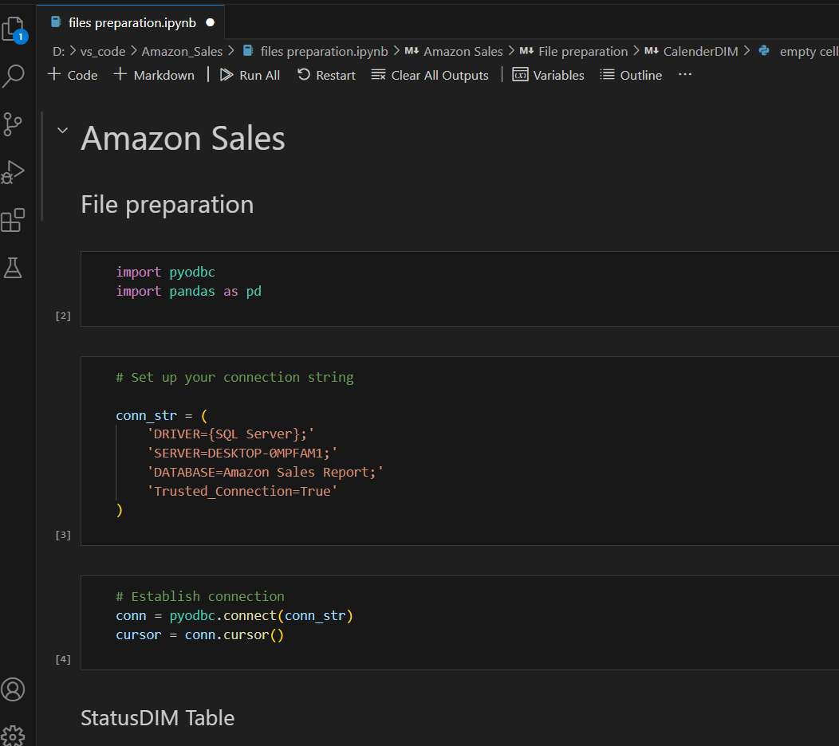
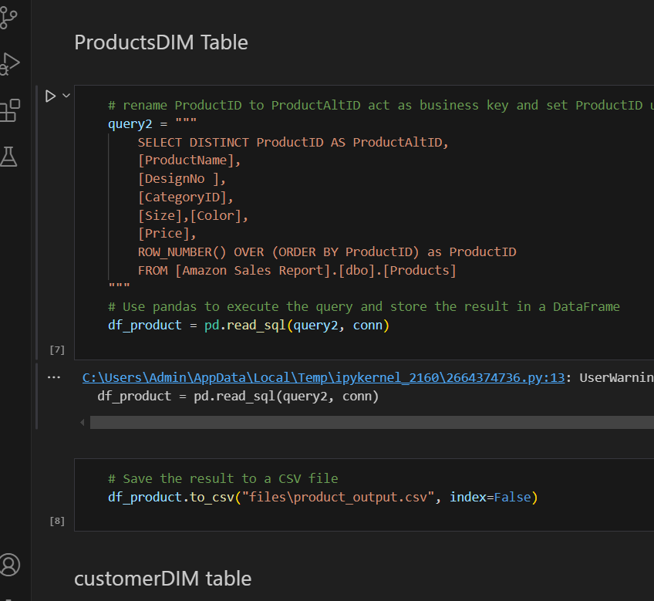
ETL & Data Preparation using python

Slide 27
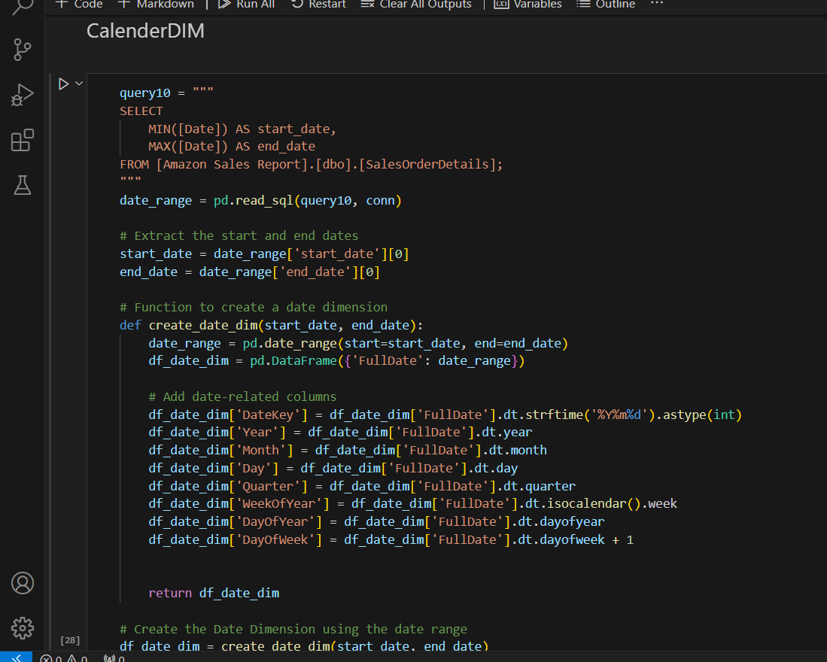
ETL & Data Preparation using python
Create Calendar Dimension

Slide 28
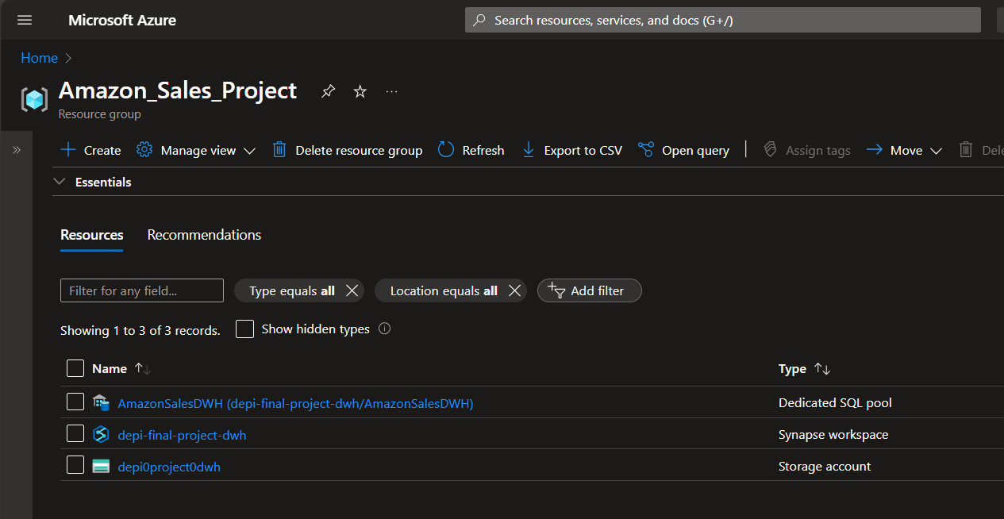
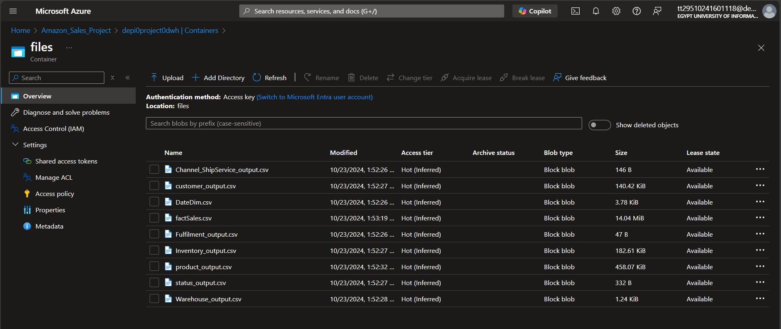
Build data warehouse using Azure synapse analytics
Create Azure synapse workspace
Load files into synapse data lake

Slide 29
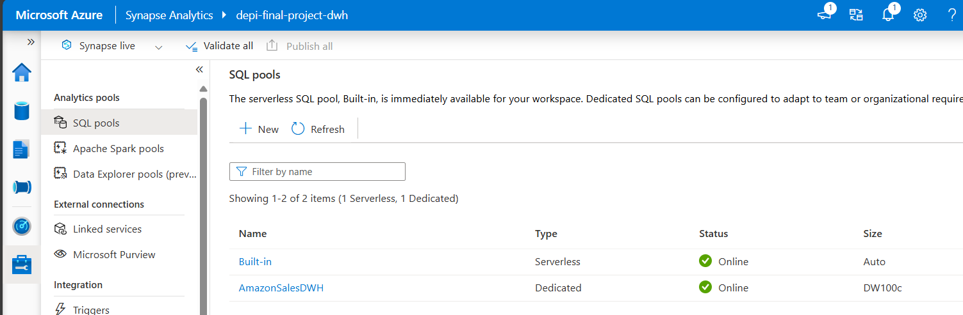
Build data warehouse using Azure synapse analytics
Create dedicated SQL pool (AmazonSalesDWH)

Slide 30
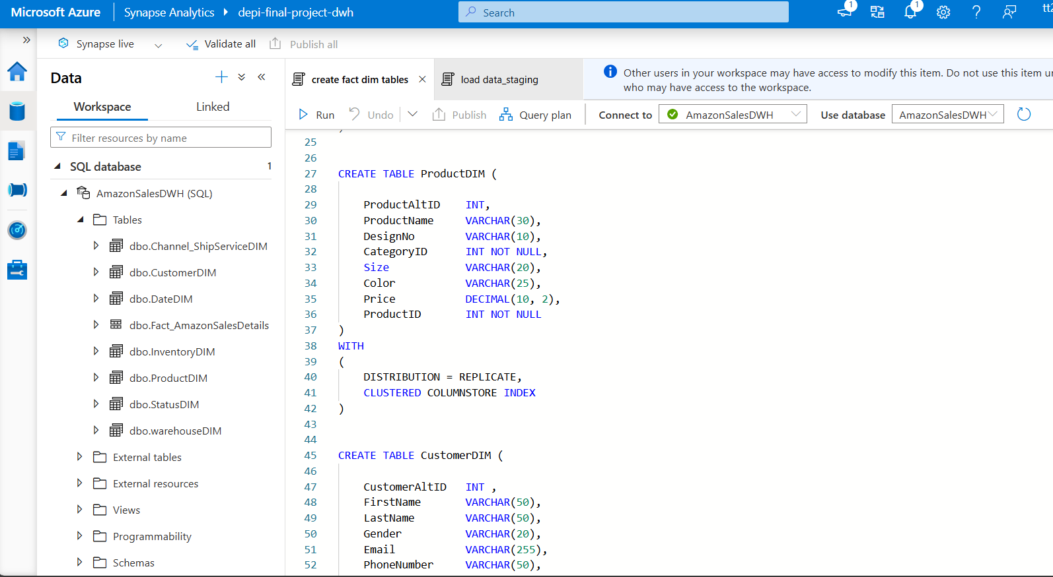
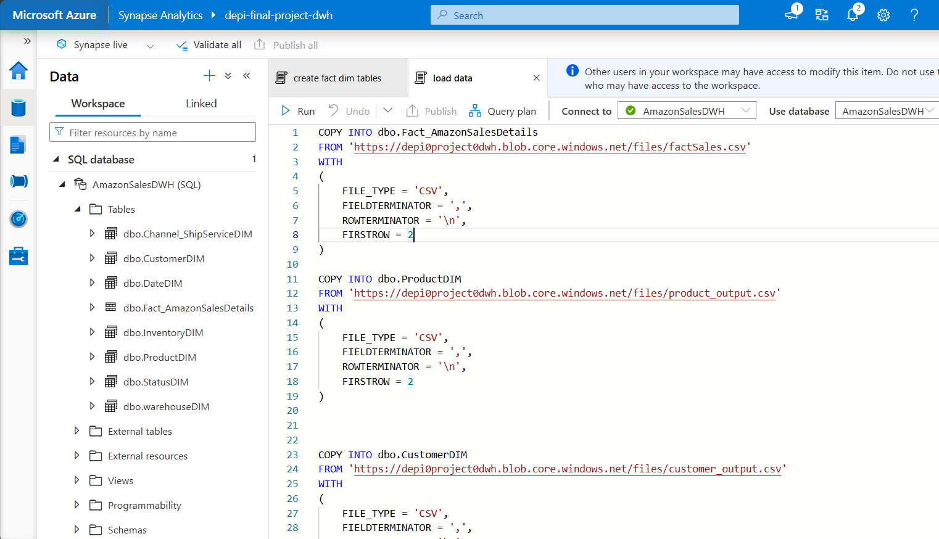
Build data warehouse using Azure synapse analytics
Create data warehouse facts and dimensions
Load data from data lake to fact & dimensions

Slide 31
Recourses & Files
https://drive.google.com/drive/folders/1wRNT4GCW-oP0U8Rc7Y5niHLI_yR9pR4s

Slide 32
THANK YOU

